Slide 1


Introduction to Python Programming
SIMCODES 2026
Iowa State University | Ames National Lab Dulitha Prasanna
06/03/2026

Slide 2

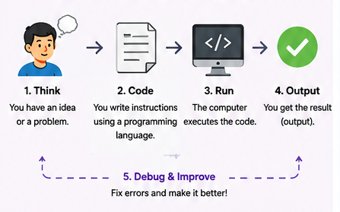
What is a programming language?
Give a computer step-by-step instructions (a program) to solve a problem or a specific task.
Is a sort of rules and symbols that allow us to communicate with computers.
Human Languages - English, French …
Machine Languages – 0’s and 1’s
Programming Languages – Python, Java, C …
Act as an intermediary between humans and computers, translating ideas into instructions that computers can understand.

Slide 3
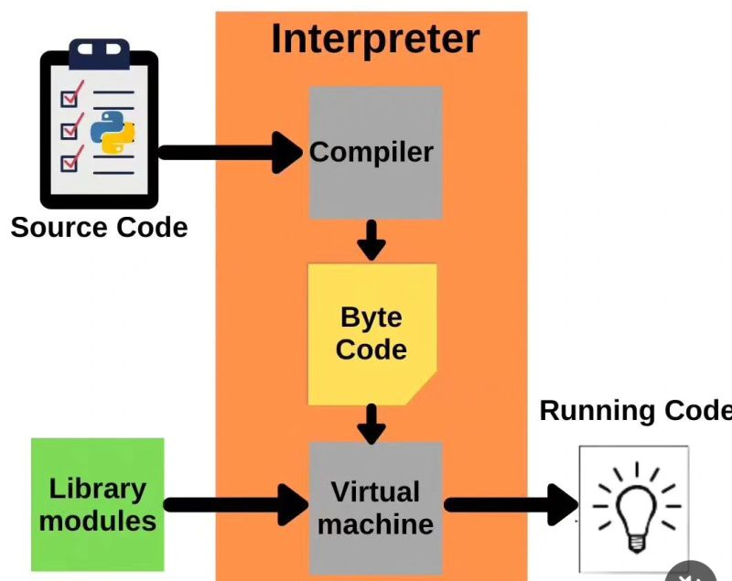
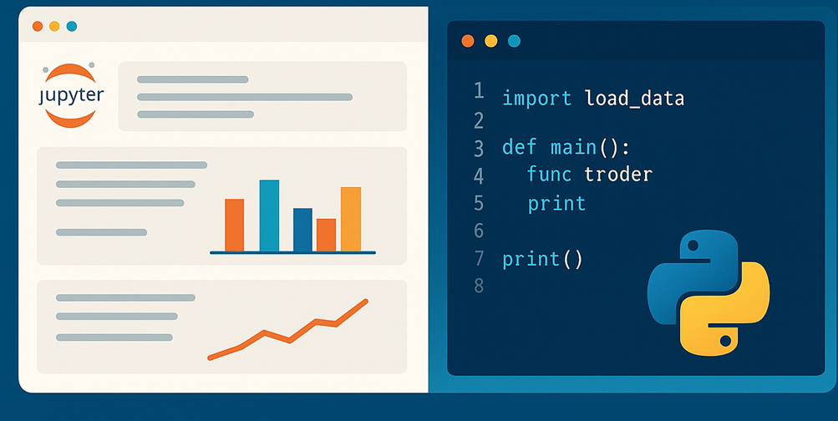
Python Programming
Python scripts are plain-text files executed from top to bottom, whereas Jupyter Notebooks are interactive scripts split into executable cells.

Slide 4

First Program
Create hello.py to run the script, python hello.py in the terminal
Create hello.ipynb and choose the venv Python kernel and run the cell.

Slide 5
Variables and Data Types
age = 21
pi = 3.14
molecule = "Ethanol"
is_valid = True
print(age)
print(pi)
print(molecule)
print(is_valid)
print(type(age))
What is a Variable?
A variable stores information (data) in memory that can be reused.
Data types define what kind of information the variable contains.
Python automatically determines the type based on the assigned value. Dynamic typing
Data Type | Example | Description
Integer (int) | 10 | Whole numbers
Float (float) | 36.5 | Decimal numbers
String (str) | "Hello" | Text
Boolean (bool) | True | True/False values

Slide 6
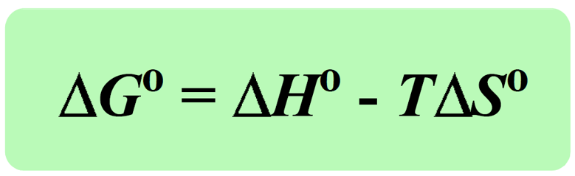
Chemistry Problem - Calculate Gibbs Free Energy
Task
Assign variables and calculate ΔG.
Given:
ΔH = -541.5 kJ/mol
T = 298 K
ΔS = 10.4 kJ/mol·K
Write a Python program to print ΔG.
deltaH = -541.5 #kJ/mole
deltaS = 10.4 #kJ/(mole K)
temp = 298 #Kelvin
deltaG = deltaH - temp * deltaS
deltaH, deltaS, temp = -541.5, 10.4, 298
deltaG = deltaH - temp * deltaS
print(deltaG)

Slide 7
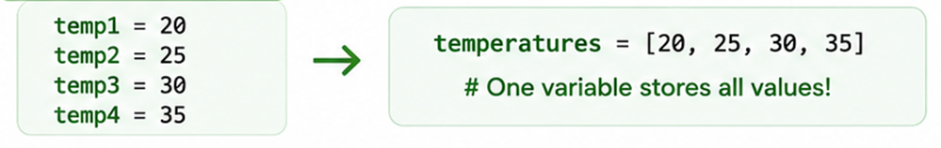
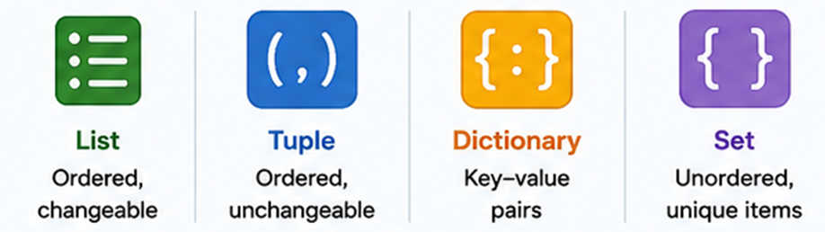
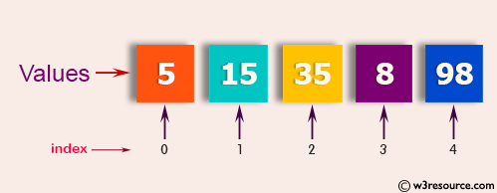
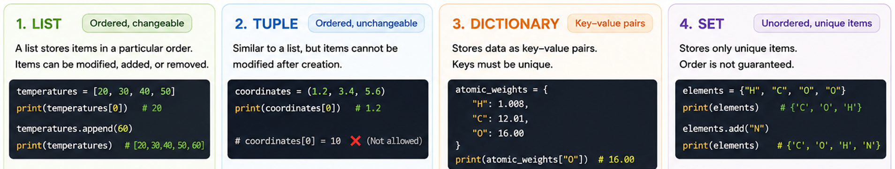
Containers
Store many values in a single variable.

Slide 8
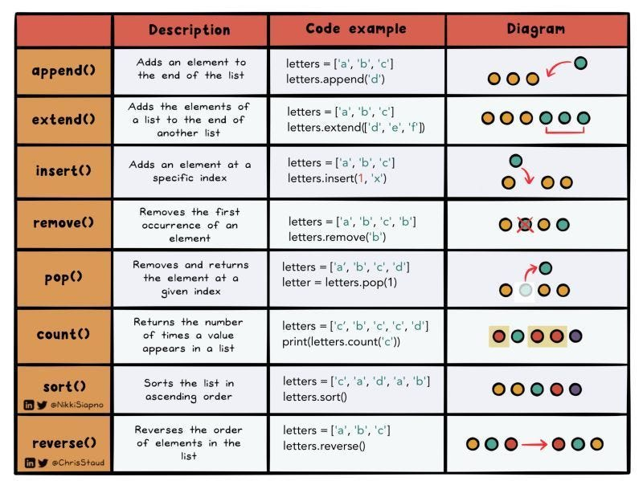
List Methods and Slice
# This is a list
energy_kcal = [-13.4, -2.7, 5.4, 42.1]
# I can determine its length
energy_length = len(energy_kcal)
# print the list length
print('The length of this list is', energy_length)
print(energy_kcal[0])
energy_kilojoules = energy_kcal[1] * 4.184
print(energy_kilojoules)
Slicing a list
new_list = list_name[start:end]
short_list = energy_kcal[0:2]
slice1 = energy_kcal[1:]
slice2 = energy_kcal[:3]
print('slice1 is', slice1)
print('slice2 is', slice2)
https://medium.com/@tanvijain17/learn-to-code-in-python-lists-012a5aefe6a7

Slide 9
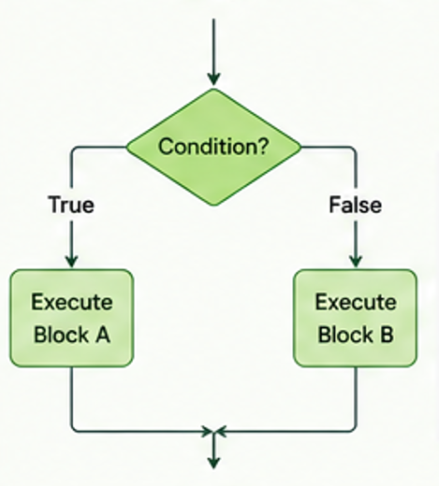
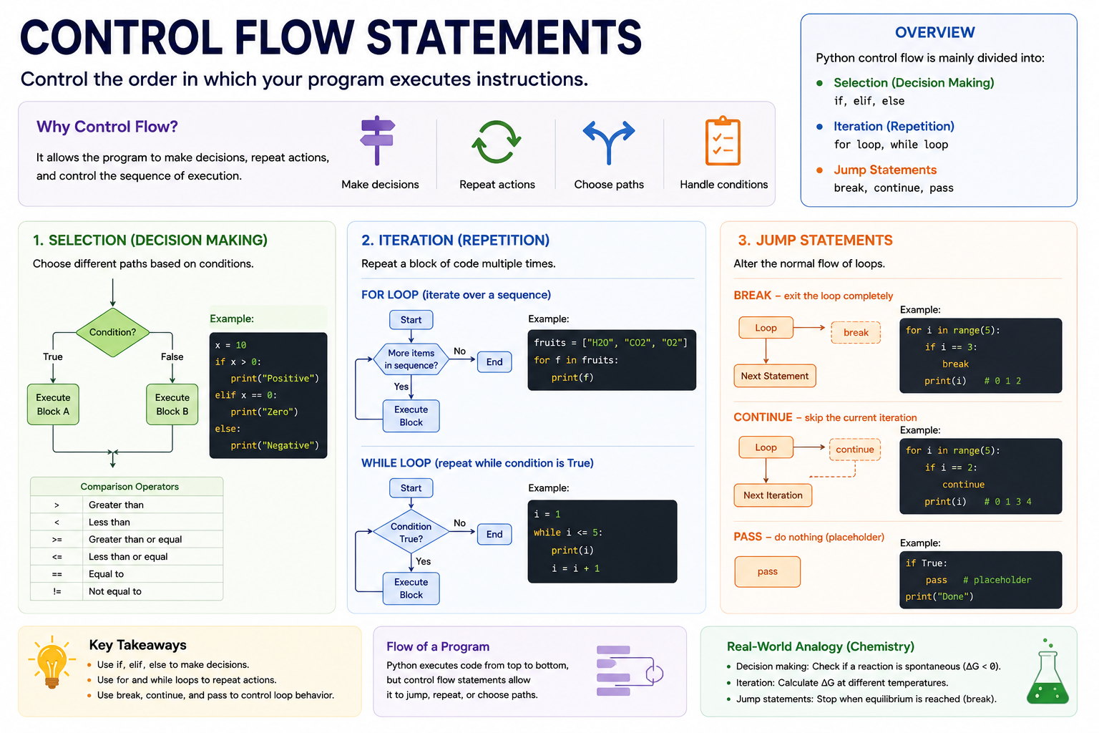
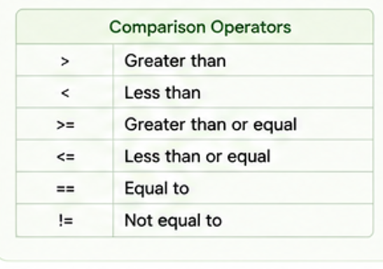
Control Flow Statements
Python Control flow is mainly divided into:
Selection (Decision Making) - if, elif, else
Iteration (Repetition) - for loop, while loop
Jump Statements - break, continue, pass
deltaG = -1.0
if deltaG < 0 :
print(‘Spontaneous’)
elif deltaG > 0:
print(‘non-spontaneous’)
else:
print(‘equilibrium’)

Slide 10
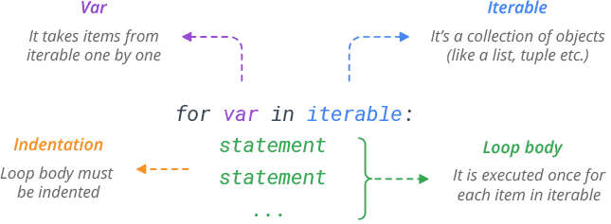
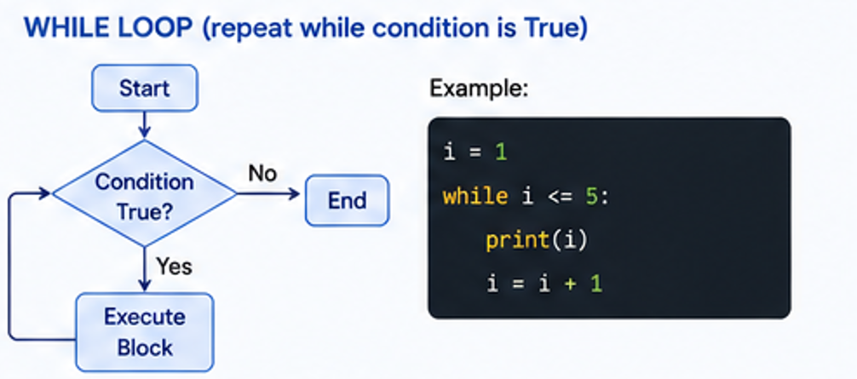
Loops
temperatures = [20, 30, 40, 50,60]
print(temperatures[0])
print(temperatures[1])
print(temperatures[2])
print(temperatures[3])
print(temperatures[4])
for temperature in temperatures:
print(temperature)
range(start, stop, step)
print(range(5))
for i in range(1, 6):
print(i)
for i in range(1, 6):
print(i)
for i in range(0, 11, 2):
print(i)

Slide 11
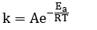
Jump Statements
Task
Select a catalyst that provides a safe and efficient reaction rate at room temperature (298 K). You will calculate the rate constant (k) using the Arrhenius equation:
K is the rate constant (s⁻¹)
A is the pre-exponential factor (assume 1.0 x 10¹³ s⁻¹)
Ea is the activation energy in J/mol
R is the ideal gas constant (8.314 J/(mol K))
T is the temperature in Kelvin (298 K)
You have a dictionary containing 5 different Ea for catalysts. Ea = [85000,75000,50000,40000,30000]
Write a script that loops through the dictionary and calculates the rate constant k for each catalyst using the math.exp() function (import math). If k is less than 0.01, the reaction is too slow,
Print a message and skip to the next catalyst (continue).
If k is greater than 1000, the reaction will generate too much heat and explode! Print an emergency warning and shut down the entire screening process immediately (break).
If k is in the safe operating range, print out that you have found a viable catalyst.

Slide 12
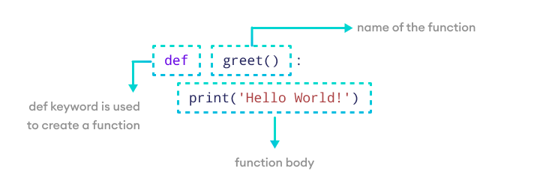
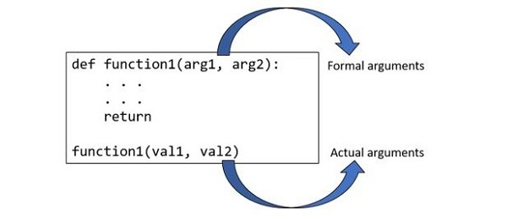
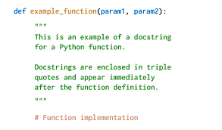
Functions
Task
a)Write a function to calculate ΔG.
b) Extend this function to print whether the reaction is spontaneous or not.
c) Evaluate this function for
ΔH = -250 kJ/mol ΔS = 10.0 kJ/mol·K
and ΔH = 250 kJ/mol ΔS = 10.0 kJ/mol·K
At T = 298 K.
Adding a docstring to a function, a block quote directly underneath the function definition.

Slide 13
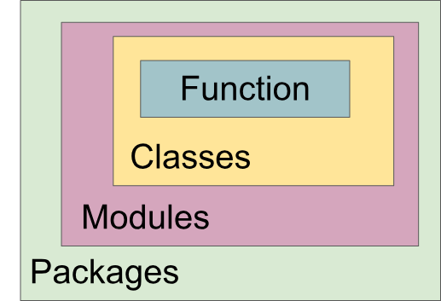
Scientific Software Design with Python
Python software has three flavors: modules, packages, and libraries.
A module is a single *.py file.
Modules are building blocks of packages and libraries.
All the actual effort goes into writing modules.
Packages are modules distributed together.
Name of the directory will be the name of the package.
The __init__.py file is usually empty, but is essential because that's how Python determines your directory is a package.
The *.py files are plain text and are where you put the code.

Slide 14
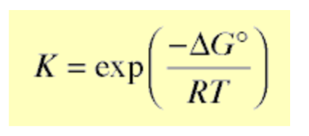
Python Package for Reaction Analysis
reaction_analysis/ ├── reaction_analysis/ │ ├── __init__.py │ ├── thermodynamics.py
├── main.py │ ├── tests/ │ └── test_thermodynamics.py │ ├── README.md
main.py
from reaction_analysis.thermodynamics import …
# Reaction parameters
delta_H = -100 # kJ/mol
delta_S = -0.2 # kJ/mol/K
T = 298 # K
R = 0.008314 #kJ /mol/K
# Calculations
delta_G = calculate_delta_g(
delta_H,
delta_S,
T
)
K_eq = calculate_equilibrium_constant(
delta_G,
T
)
reaction_type = classify_reaction(
delta_G
)
thermodynamics.py
Function for reaction type (exothermic or endothermic)
Function for delta G calculation
Function for spontaneity
Function for equilibrium Constant

Slide 15

Tests
pip install pytest
To run in the terminal -> pytest
assert actual == expected
test_thermodynamics.py
from reaction_analysis.thermodynamics import calculate_delta_g
def test_delta_g():
result = calculate_delta_g(
-100,
-0.2,
298
)
assert result == -40.4

Slide 16
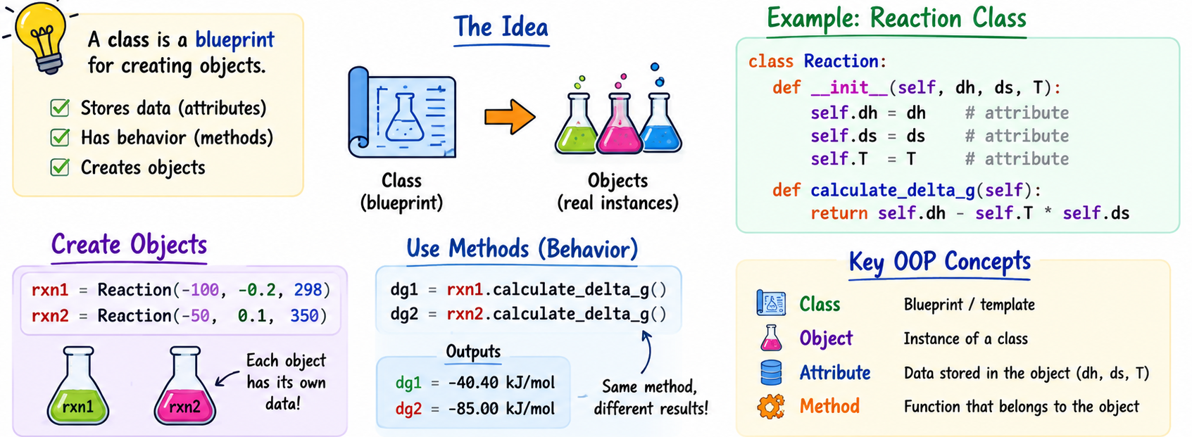
Python Classes

Slide 17
Thank You!
dulithaprasanna@gmail.com
dulitha@iastate.edu

